Slide 1
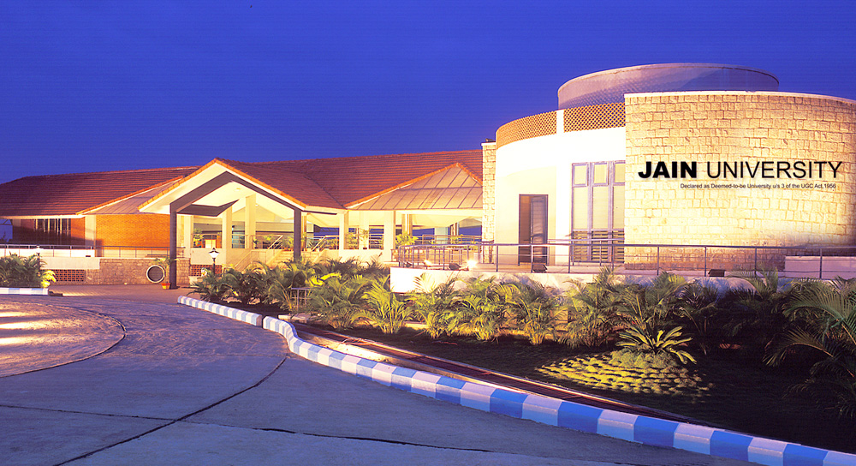

Slide 2
Title of Project
SubAud
Submitted By:
Adithya N Aditya Rajesh Gurusudhanva Mohammad Fawaaz Patel Nived PV 22BTRCO006 22BTRCO007 22BTRCO019 22BTRCO028 22BTRCO30
CSE-BFSI/IOT CSE-BFSI/IOT CSE-BFSI/IOT CSE-BFSI/IOT CSE-BFSI/IOT
Under the guidance of
Dr.Rachit Garg
CSE IOT,
School of Computer Science

Slide 3
Table of Contents
Introduction
Problem Statement
Literature Survey
Existing System
References

Slide 4
INTRODUCTION
Website which takes input from the user in the form of video file,audio file. Which generates subtitle in their own native language.

Slide 5
Problem statement:

Slide 6
Literature Survey
Tensor2Tensor for Neural Machine Translation
Abstract:
Tensor2Tensor is a library for deep learning models that is well-suited for neural machine translation. Development began focused on neural machine translation and so Tensor2Tensor includes many of the most successful NMT models and standard datasets.
Author | Year | Advantages | Problems
Ashish Vaswani1 , Samy Bengio | 2019 | T2T-specific abstractions, researchers can train models on CPU, GPU (single or multiple), and TPU, locally and in the cloud, usually with no or minimal device-specific code or configuration. | Dataset. The problem will be getting the data.The problem will arise with creating a dataset from scratch which will become a slightest problem for T2T.

Slide 7
The Multilingual TEDx Corpus for Speech Recognition and Translation
Abstract:
TEDx has released a Multilingual TEDx corpus, a collection of audio recordings from 8 source languages, designed to support speech recognition (ASR) and speech translation research. The corpus, available with open-sourced code, allows for extension to new talks and languages, improving translation performance for low-resource language pairs.
Author | Year | Advantages | Problems
Matt Post, Marco Turchi, Matthew Wiesner | 2021 | Multilingual corpus provides as with collection of audio library. | Tedx corpus provides audio for only major languages like English, French, German etc..

Slide 8
Spoken Neural Translation System for Spoken Language System:
Abstract:
This abstract explores the synergy between encode-decode and attention mechanisms in Natural Language Understanding (NLU). The encode-decode framework, inspired by sequence-to-sequence models, forms the foundation for many NLU systems. Additionally, attention mechanisms, particularly self-attention and multi-head attention, enhance NLU by capturing contextual information and improving long-range dependencies. These combined techniques have revolutionized NLU, leading to state-of-the-art performance in tasks like machine translation, text summarization, and chatbot development. Their ongoing role in advancing NLU is pivotal for improving language understanding and generation
Author | Year | Advantages | Problems
CHRISTOPHER NOLAN,HU TANG WANG | 2015 | NMT systems are able to produce more accurate and fluent translations, especially for complex and challenging text. | NMT systems are still under development, and they are not perfect. They can sometimes make mistakes, especially when translating complex or challenging text.

Slide 9
Recurrent Neural Networks: An Embedded Computing Perspective
Abstract:Recurrent Neural Networks (RNNs) are a class of machine learning algorithms used for applications with time-series and sequential data. Recently, there has been a strong interest in executing RNNs on embedded devices. However, difficulties have arisen because RNN requires high computational capability and a large memory space. In this paper, we review existing implementations of RNN models on embedded platforms and discuss the methods adopted to overcome the limitations of embedded systems. We will define the objectives of mapping RNN algorithms on embedded platforms and the challenges facing their realization. Then, we explain the components of RNN models from an implementation perspective. We also discuss the optimizations applied to RNNs to run efficiently on embedded platforms. Finally, we compare the defined objectives with the implementations and highlight some open research questions and aspects currently not addressed for embedded RNNs. Overall, applying algorithmic optimizations to RNN models and decreasing the memory access overhead is vital to obtain high efficiency. To further increase the implementation efficiency, we point up the more promising optimizations that could be applied in future research. Additionally, this article observes that high performance has been targeted by many implementations, while flexibility has, as yet, been attempted less often. Thus, the article provides some guidelines for RNN hardware designers to support flexibility in a better manner.

Slide 10
Author | Year | Advantages | Problems
NESMA M. REZK TOMAS NORDSTRÖM 1,MADHURAPURNAPRAJNA 2, 3,ANDZAINUL-ABDIN | 2017 | Recurrent Neural Networks(RNNs) are a class of Neural Net works (NNs) dealing with applications that have sequential data inputs or outputs.

Slide 11
Automatic Caption Generator
Abstract:
The last ten years have been the witnesses of the emergence of any kind of video content. In the same time, certain individuals are deaf and occasionally cannot understand the meanings of such videos because there is not any text transcription available. Hence, it becomes important to make videos available to people who have these problems and even more to remove the gaps of native languages among them. This can be best done by providing subtitles of a video. However, downloading subtitles of any video from the internet is a tedious process. So, to generate subtitles automatically through the software itself and without the use of internet is the main concept of this paper. The objective of this paper is to provide an overview of generating subtitle on offline basis using CMUSPHINX4 java API. This system will first extract the audio, then recognize the extracted audio with CMUSPHINX4 java API. Later this system writes the recognized text to the text file with timestamp and saves it with .srt extension. Then, this .srt file can be opened in a media player to view the subtitles along with video.

Slide 12
Author | Year | Advantages | Problems
Neel Patel1, Hemil Pansuria1, Jay Patel1, Bhavik Darji1, Prashant Sahatiya2 | 2015 | CMUSphinx-4 is open-source software, which means it's free to use and can be customized according to your needs and it can work offline, which means it doesn't require a constant internet connection.

Slide 13
Existing System
In the view of MT systems the existing systems would be google transaltor,microsoft translator,systran,etc..
The subtitle generator

Slide 15
PROBLEM STATEMENT
Communication Barriers:
Language is a major obstacle that prevents effective communication across nations and industries.
The rapid shift to online teaching due to the coronavirus disease of 2019 (COVID-19) exponentially increased the extent to which faculty use videoconferencing/virtual classroom tools such as Zoom, Google Meet, and Microsoft Teams. But online classes are very much less effective than offline classes. The main reason is language barrier which make it difficult for students to understand lectures. How to solve this?

Slide 16
OBJECTIVE and SUB-OBJECTIVES
Objective: To create a translating website that can break language barriers and facilitate seamless online communication.
Sub-Objectives:
Correct and efficient translation.
Adapt to different languages and accents.
Provide high-quality translation without latency.
Optimize for different environments, such as noisy or crowded spaces.
It will be helpful to the impaired person(person with Disabilty).

Slide 17
INTRODUCTION
In today's dynamic and interconnected world, video content has become an integral part of our lives, facilitating communication, entertainment, and education.
However, language barriers often hinder the seamless accessibility of these videos to a global audience.
To address this challenge, we present our ambitious project: the development of a cutting-edge website that empowers users to effortlessly process videos and obtain accurate subtitles in their desired language.

Slide 18
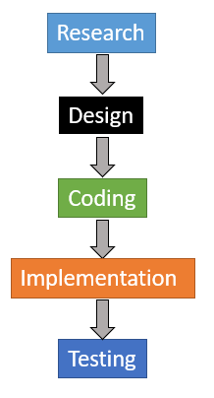
STEPS to FOLLOW
Video Upload and Analysis:
Step 1: Users upload their videos to the website.
Step 2: The system processes the uploaded videos to extract audio content.
Natural Language Proceesing:
Natural language processing (NLP) is a machine learning technology that gives computers the ability to interpret, manipulate, and comprehend human language.
Automatic Speech Recognition (ASR):
Step 3: Utilizing advanced ASR technology, the system converts the audio into text transcripts. It stores voice into an (Waveform Audio File Format or .wav)
Language Detection
Step 4: The system detects the language of the transcribed text to ensure accurate translations.
Machine Translation:
Step 5: Using cutting-edge machine translation, the transcribed text is translated into the user's desired language.
Subtitle Generation:
Step 6: Subtitles are generated in real-time, synchronized with the video content.
2. User-Friendly Interface:
Step 7: The website offers an intuitive and easy-to-use interface for users to upload videos and choose languages.

Slide 19
3.Privacy and Security:
Step 8: User data and uploaded videos are securely stored and protected following industry-standard practices.
Scalability and Performance:
Step 9: The system is designed to handle a large number of users and ensure smooth performance.
4.Continuous Improvement:
Step 10: Regular updates and feedback from users are incorporated to enhance accuracy and user experience.
5.Multilingual Accessibility:
Step 11: The platform supports multiple languages, enabling global accessibility and inclusivity.
6.Cloud-Based Hosting:
Step 12: The website is hosted on a reliable cloud infrastructure for seamless accessibility from anywhere.
7.Cross-Device Compatibility:
Step 14: The website is optimized for various devices, including desktops, tablets, and smartphones.
8.Quality Assurance:
Step 15: Rigorous testing and quality assurance measures ensure accurate subtitles and translations.

Slide 20
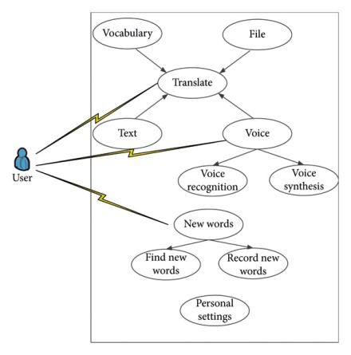
Use Case Diagram for the Application

Slide 21
LITERATURE SURVEY
Speech to Text Translation enabling Multilingualism 2020-Shahana Bano,Pavuluri Jithendra,Gorsa Lakshmi Niharika,Yalavarthi Sikhi
They proposed their a Speech Recognition model that converts the speech data given by the user as an input into the text format in his desired language. This model is developed by adding Multilingual features to the existent Google Speech Recognition model based on some of the natural language processing principles.one among them is you can survive in unknown places where we don’t know the language to speak but with help of this model we can translate that regional speech to text and it can also be used in areas like telecommunication and multimedia
The Multilingual TEDx Corpus for Speech Recognition and Translation:2021-Elizabeth SaleskyÃ Matthew WiesnerÃ Jacob Bremermanm Roldano Cattonif Matteo NegrifMarco Turchif Douglas W. Oardm Matt Post They present the Multilingual TEDx corpus, built to support speech recognition (ASR) and speech translation (ST) research across many non-English source languages. The corpus is a collection of audio recordings from TEDx talks in 8 source languages.

Slide 22
Video Based Transcript Summarizer for Online Courses using Natural Language Processing:2021-Krishna Kulkarni, Rushikesh Padaki
Their system focuses on the development of a module using Natural Language Processing with python to summarize an online class video. The methodology adopted in this project uses Natural Language Processing (NLP) algorithms such as Term Frequency- Inverse Document Frequency (TF-IDF) and Gensim to obtain the summary of video of online course.
An Approach Towards Generating Subtitles Automatically from Videos by Extracting Audio:2018-Rizwan Sheikh,Swapnil Suryajoshi,Shivam Gupta,Sushant Tayde,M. S. Burange They created a model to generate subtitles automatically with the help of speech recognition technology. They used two models help to generate subtitles for videos, Audio Extraction helps to extract audio from video and convert into .wav format for speech recognition process. PocketSphinx speech recognition engine the .wav file get processed and the speech is get converted into text format and stored in .srt file for future use.

Slide 23
CONCLUSION
Our mission is to create an innovative online platform that utilizes the latest advancements in artificial intelligence and natural language processing.
Through this platform, users will be able to upload videos in various formats, spanning from educational lectures to engaging vlogs or captivating documentaries.
The system will then autonomously analyze the audio content, transcribe it into text, and subsequently translate it into the user's preferred language, thus generating accurate subtitles in real-time.

Slide 24
REFERENCES
Speech to Text Translation enabling Multilingualism 2020-Shahana Bano,Pavuluri Jithendra,Gorsa Lakshmi Niharika,Yalavarthi Sikhi
The Multilingual TEDx Corpus for Speech Recognition and Translation:2021-Elizabeth SaleskyÃ Matthew WiesnerÃ Jacob Bremermanm Roldano Cattonif Matteo NegrifMarco Turchif Douglas W. Oardm Matt Post
Video Based Transcript Summarizer for Online Courses using Natural Language Processing:2021-Krishna Kulkarni, Rushikesh Padaki
An Approach Towards Generating Subtitles Automatically from Videos by Extracting Audio:2018-Rizwan Sheikh,Swapnil Suryajoshi,Shivam Gupta,Sushant Tayde,M. S. Burange

Slide 25
THANK YOU

